Slide 1
DIGITAL MARKETING PHASE 2
BRITANNIA
S.HYDERBASHA (TL)
T. URMIKADEVI
ANKITHA YADAV
B.SAMYUKTHA

Slide 2
Brand study
BRAND NAME : BRITANNIA
MISSION :To provide financial services with the traditional banking values of quality
services and knowledge of its clients.
USP : India’s very own bakery and diary products brand that is trusted for its quality.

Slide 3
COMPETITOR ANALYSIS
COMPETITOR -1: ITC
USP : Delivering high quality products and services across diverse portfolio.
ONLINE COMMUNICATION : Facebook ,Twitter , Instagram

Slide 4
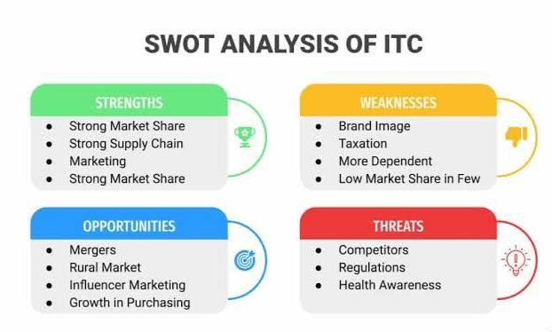
SWOT ANALYSIS OF ITC :

Slide 5
COMPETITOR -2: NESTLE
USP : Improving the nutrition, health, and wellness of the society.
ONLINE COMMUNICATION: Facebook, Instagram, Twitter

Slide 6
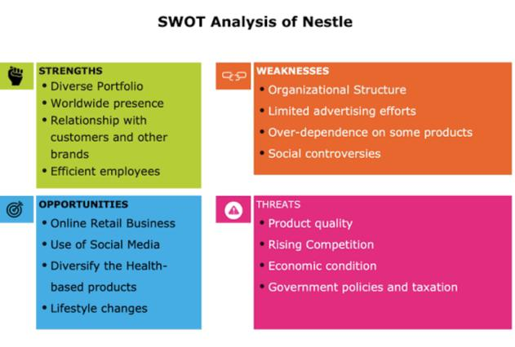
SWOT ANALYSIS OF NESTLE :

Slide 7
COMPETITOR-3: PARLE
USP : Nutritional benefits.
ONLINE COMMUNICATION : Facebook, Instagram, Twitter.

Slide 8
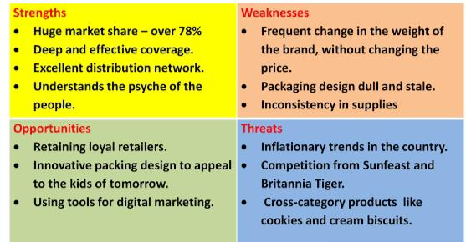
SWOT ANALYSIS OF PARLE :

Slide 9
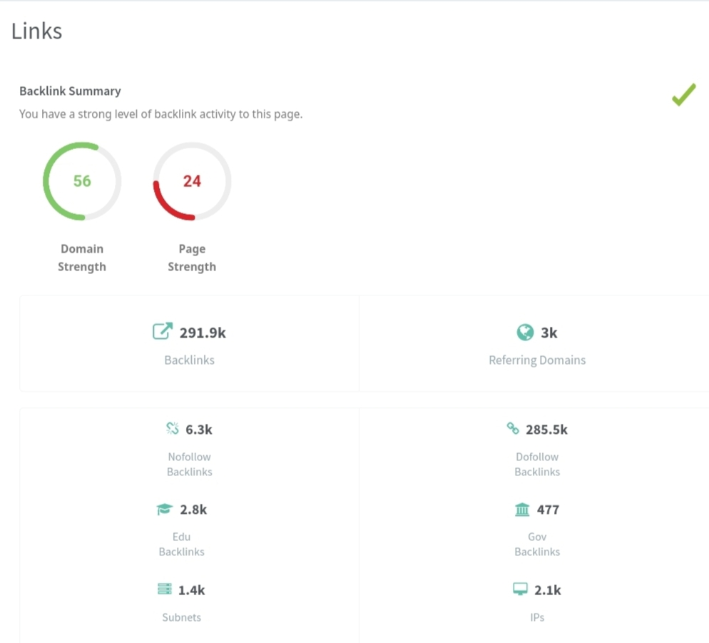
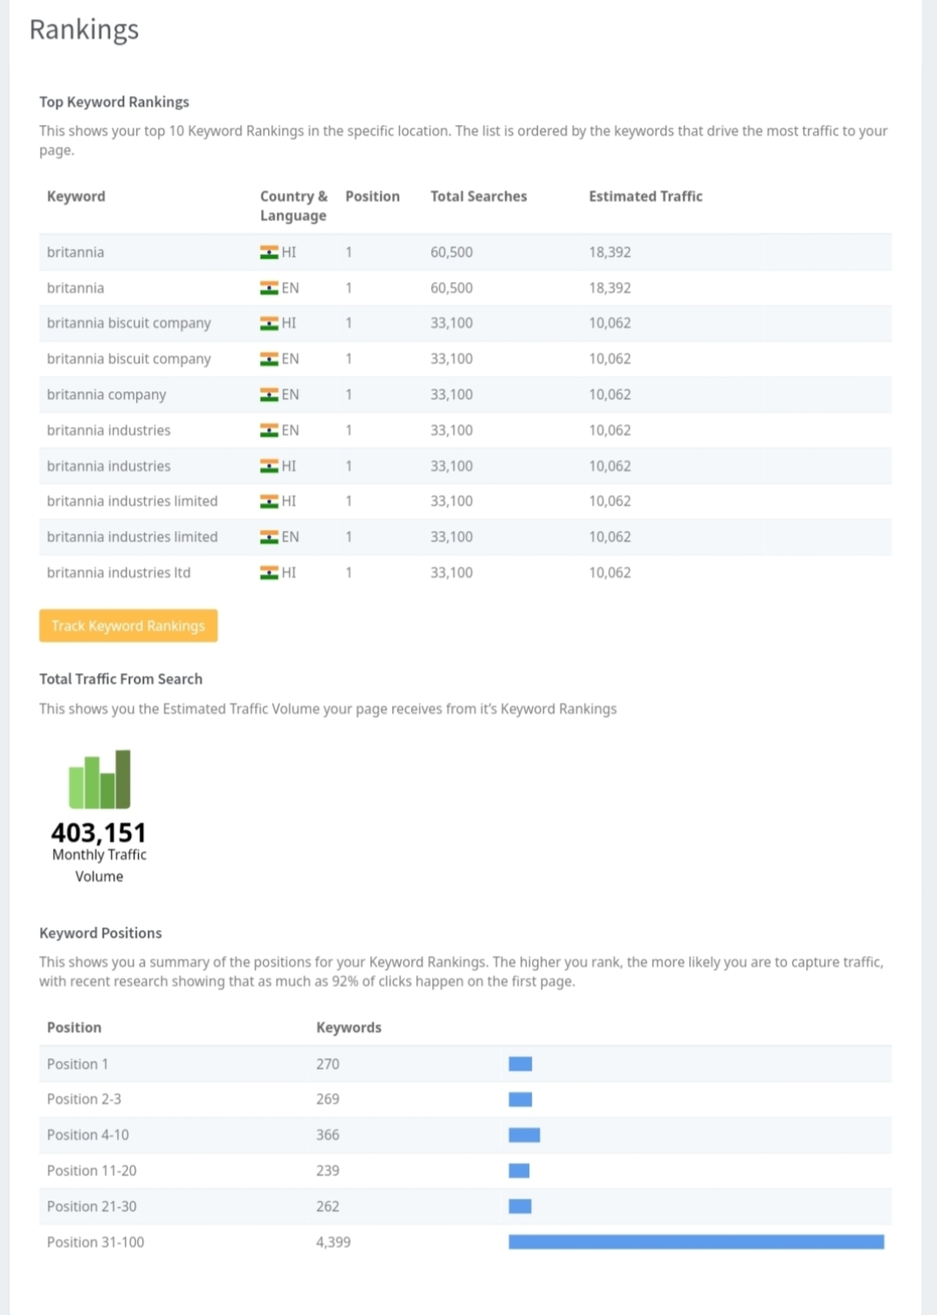
SEO AUDIT

Slide 10
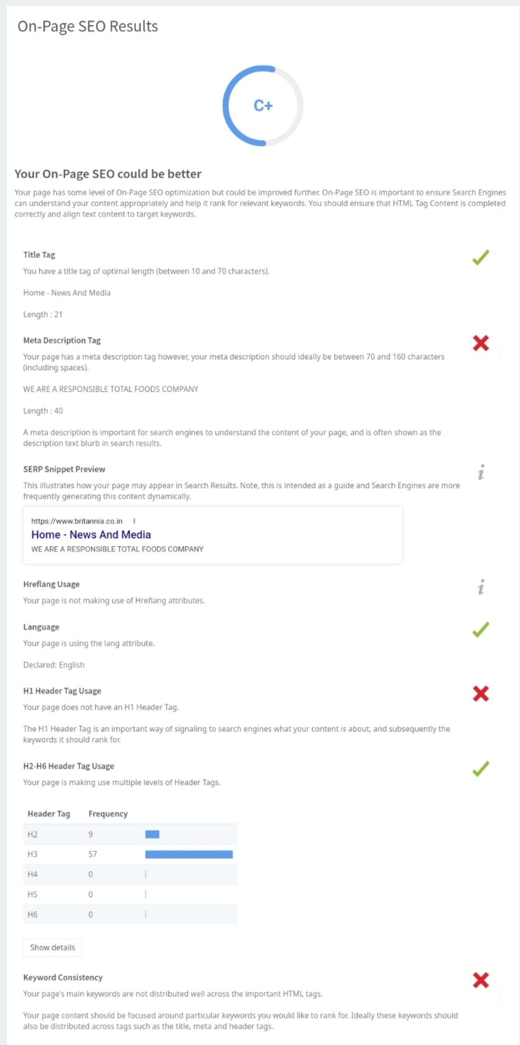
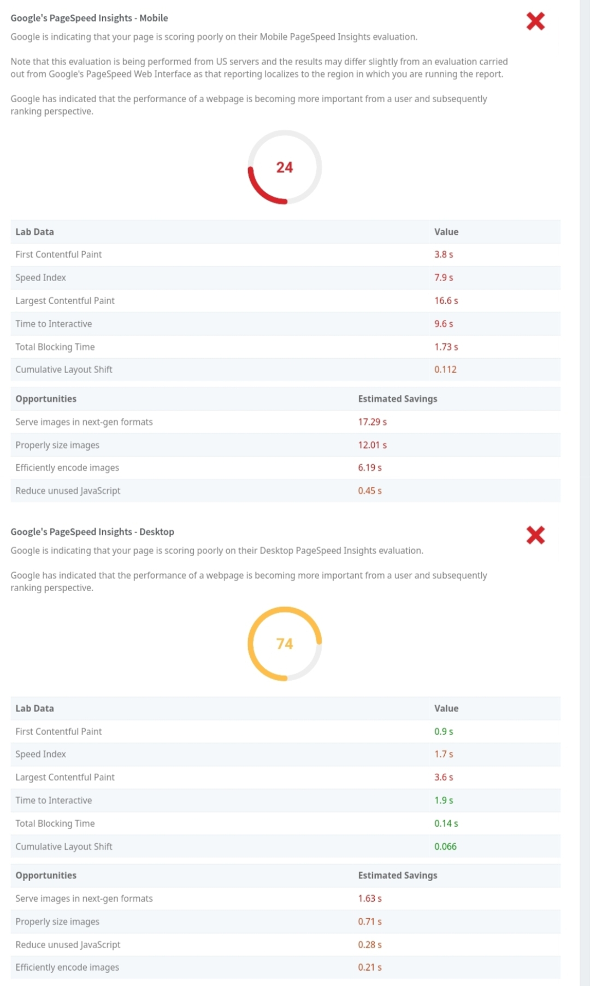
SEO audit

Slide 11
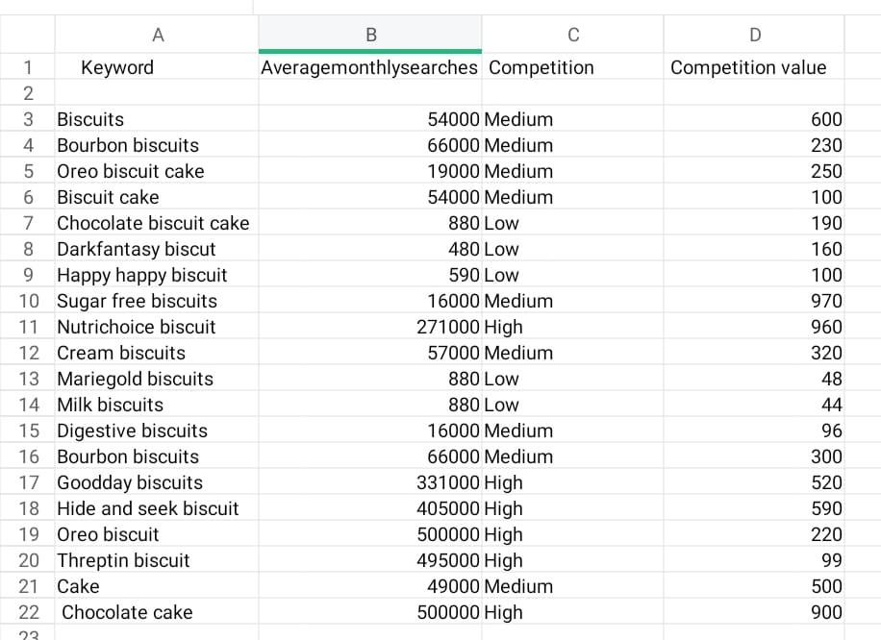
Keyword research

Slide 12
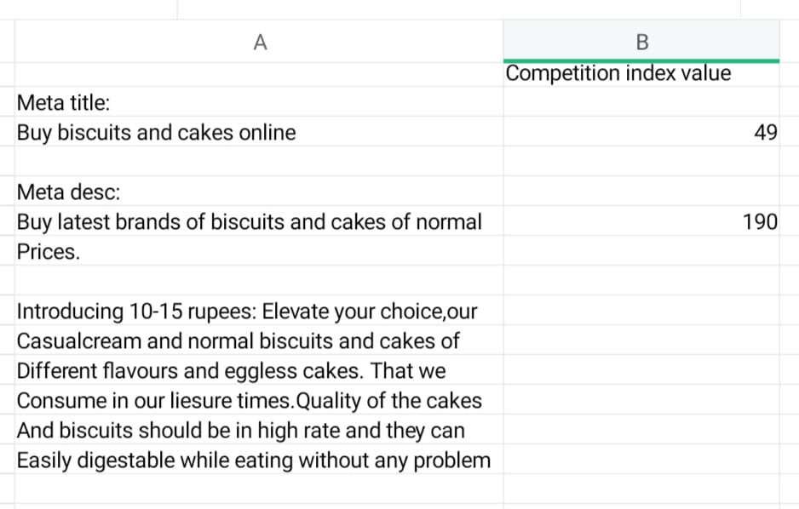
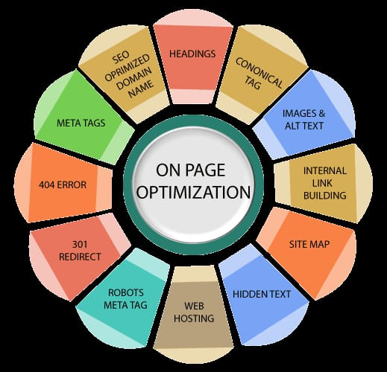
On page optimization

Slide 13
Content idea and marketing strategies
CONTENT CALENDER :
SUNDAY | MONDAY | TUESDAY | WEDNESDAY | THURSDAY | FRIDAY | SATURDAY
15 | 16 | 17 | 18 | 19 | 20 | 21
Created content | New blogs | Post uploading | webinar | Updated blogs | Group engagement | Product launch
22 | 23 | 24 | 25 | 26 | 27 | 28
campaign | Facebook & Instagram chat | webinar | campaign | Product lunch | New blogs | Curated content
29 | 30 | 31
Story created | Target customers | Group engagement

Slide 14
CONTENT CREATION AND CURATION
ACCOUNT LINK : https://www.instagram.com/susabritannas/?igshid=MzRlODBiNWFlZA%3D%3D
REEL LINK : https://www.instagram.com/reel/CyaNCX2vhqo/?igshid=MmU2YjMzNjRlOQ%3D%3D
CAROUSEL POST LINNK : https://www.instagram.com/p/CyaIZTzvm_l/?igshid=NTc4MTIwNjQ2YQ==
POST LINK : https://www.instagram.com/p/CyaJ76GvpCA/?igshid=MmU2YjMzNjRlOQ%3D%3D

Slide 15
INSTAGRAM STORY
STORY DAY 1 : https://www.instagram.com/stories/susabritannas/3213921836462978530/?utm_source=ig_story_item_share&igshid=YTUzYTFiZDMwYg%3D%3D
HIGHLIGHTS DAY 1 : https://www.instagram.com/s/aGlnaGxpZ2h0OjE4MDA0NDc4NDM0OTA1MTMx?story_media_id=3213921836462978530_62289511895&igshid=NTc4MTIwNjQ2YQ==
STORY DAY 2 : https://instagram.com/stories/susabritannas/3213925381270534318?utm_source=ig_story_item_share&igshid=YTUzYTFiZDMwYg==
HIGHLIGHTS DAY 2 : https://instagram.com/stories/susabritannas/3213925381270534318?utm_source=ig_story_item_share&igshid=NjZiM2M3MzIxNA==

Slide 16


